Slide 1
Kernel VS QELM

Slide 2
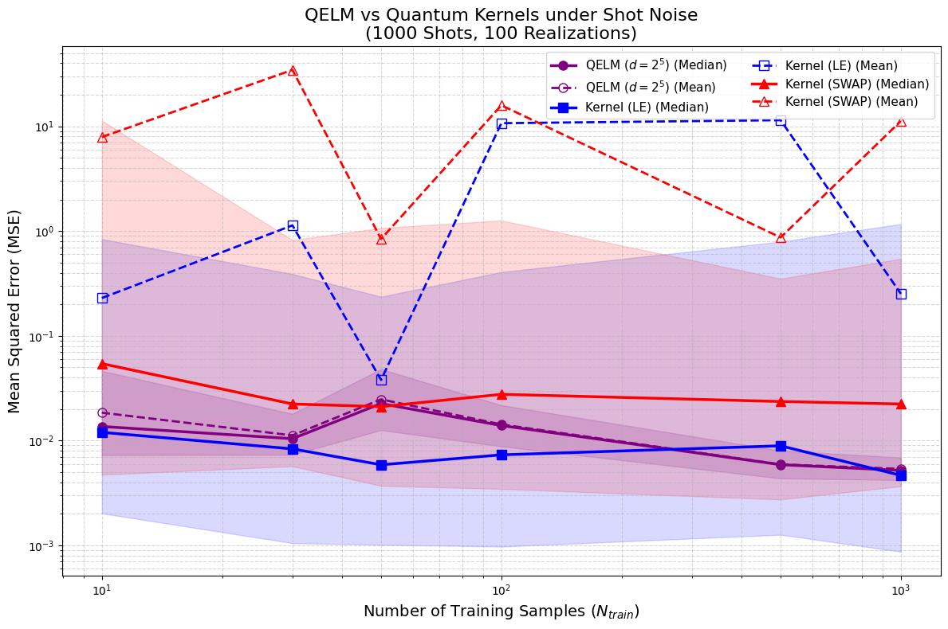
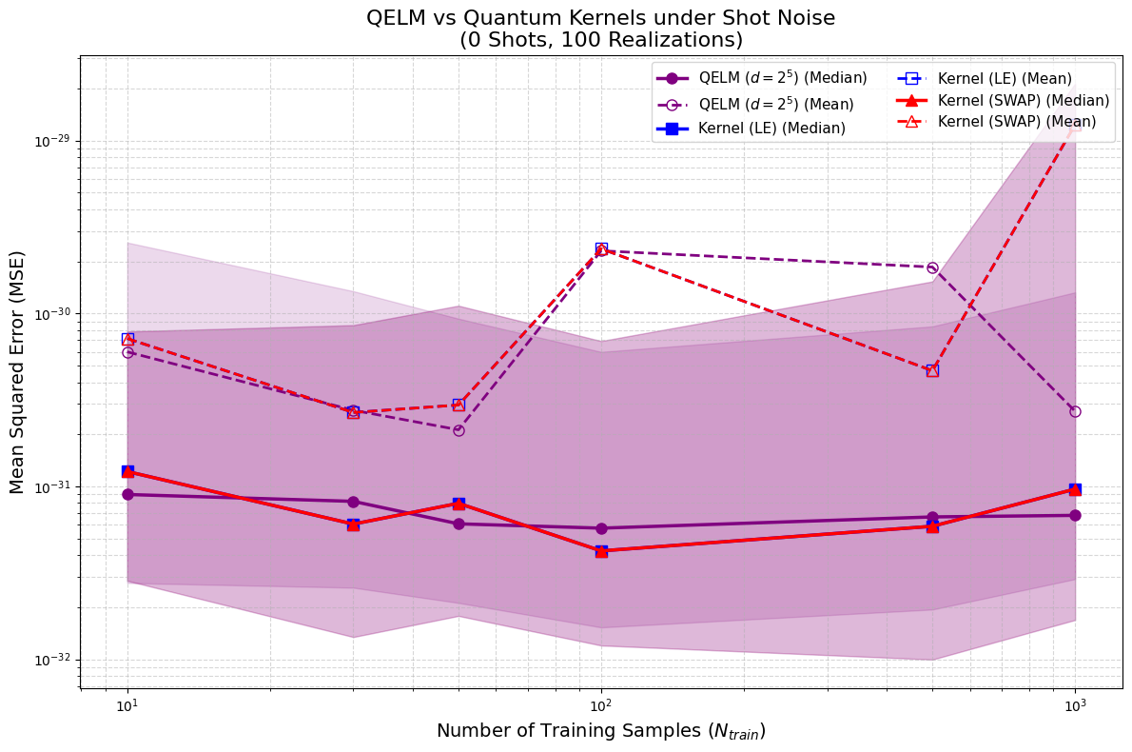
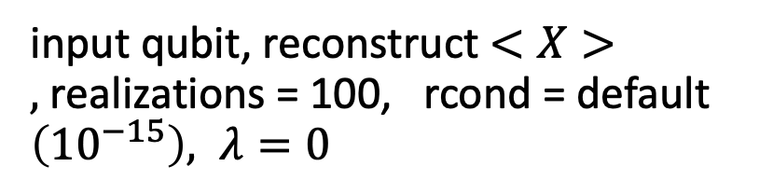
Quantum Kernel VS QELM
input qubit, reconstruct $<X>,$realizations = 100, rcond = default $\left({10}^{−15}\right), λ=0$

Slide 3
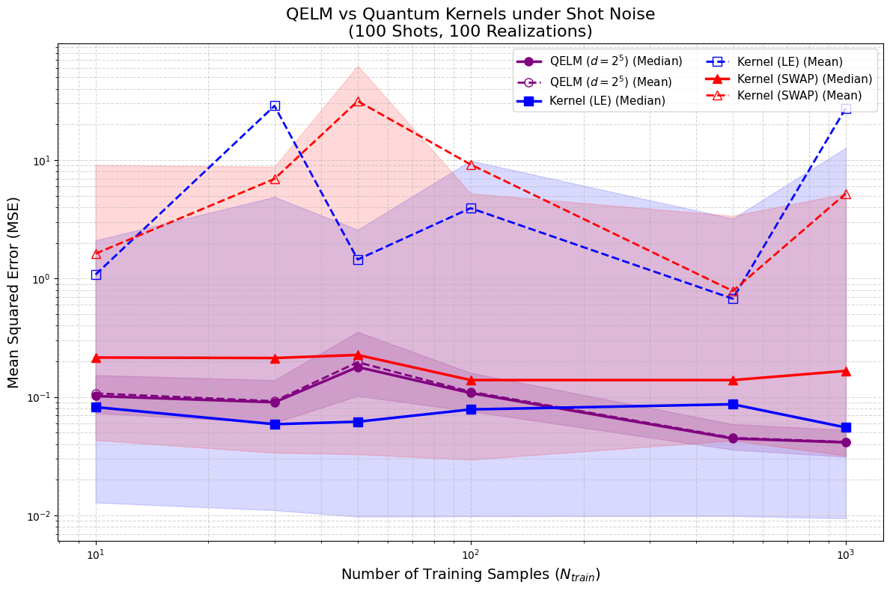
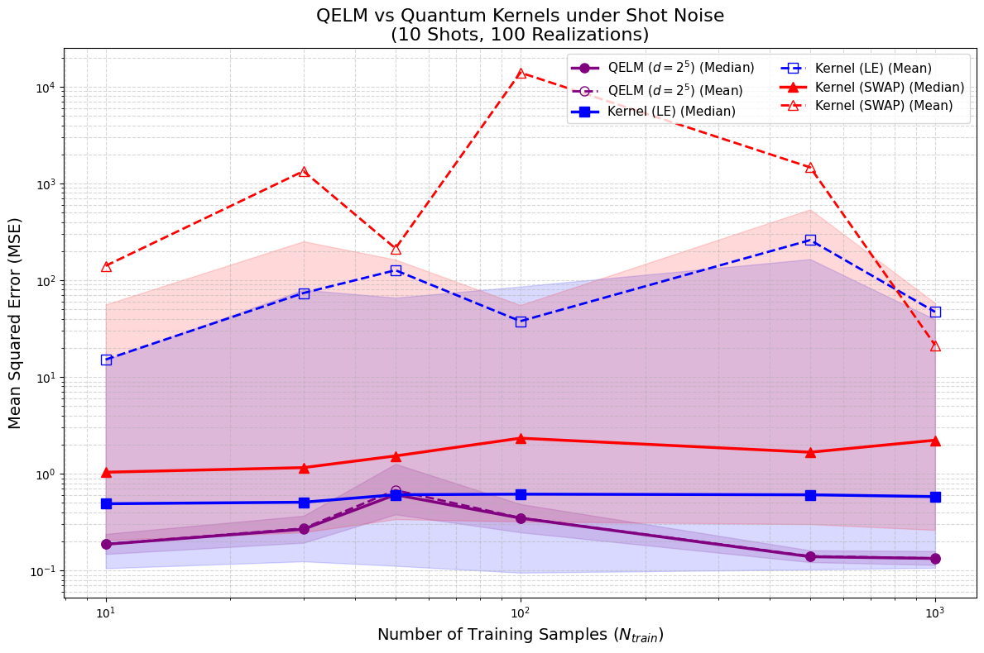
Quantum Kernel VS QELM
input qubit, reconstruct $<X>,$realizations = 100, rcond = default $\left({10}^{−15}\right), λ=0$

Slide 4
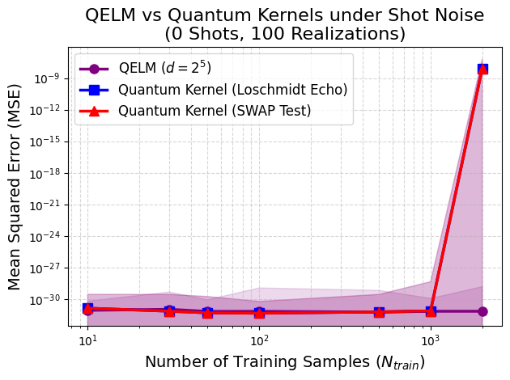
Median

Slide 5
Kernel numerical instability

Slide 6
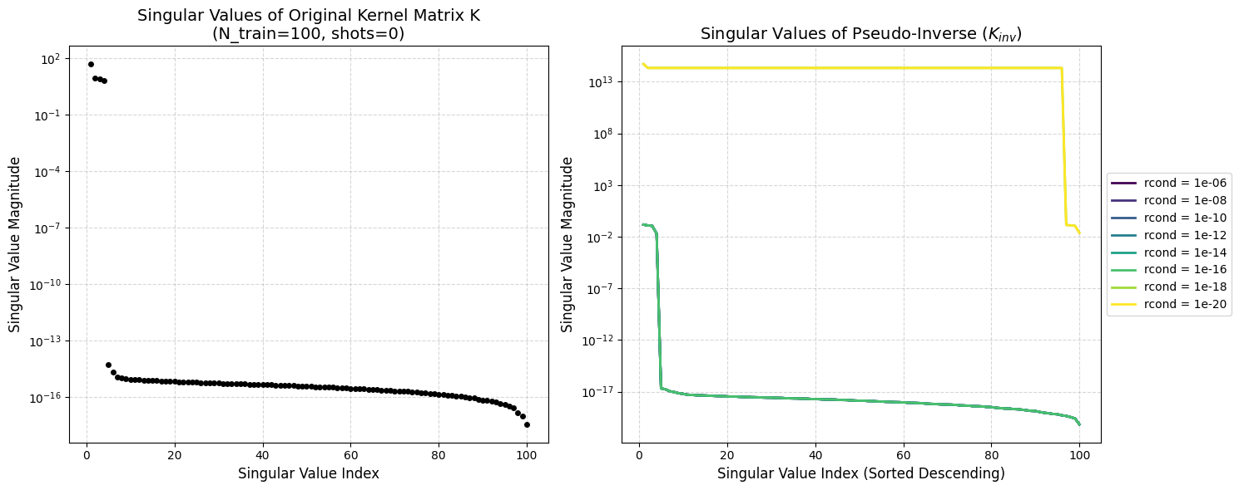
KernelSVD, N_train=100

Slide 7
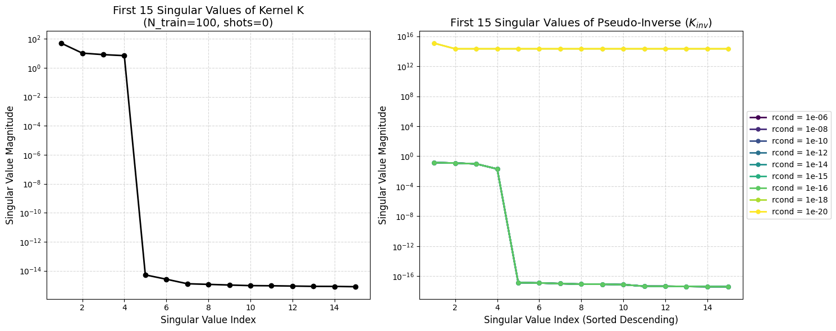
KernelSVD, N_train=100
Pinv -> rcond = 1e-15 (default)

Slide 8
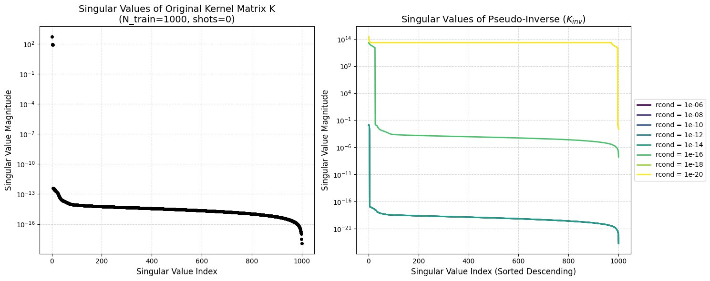
KernelSVD, N_train=1000

Slide 9
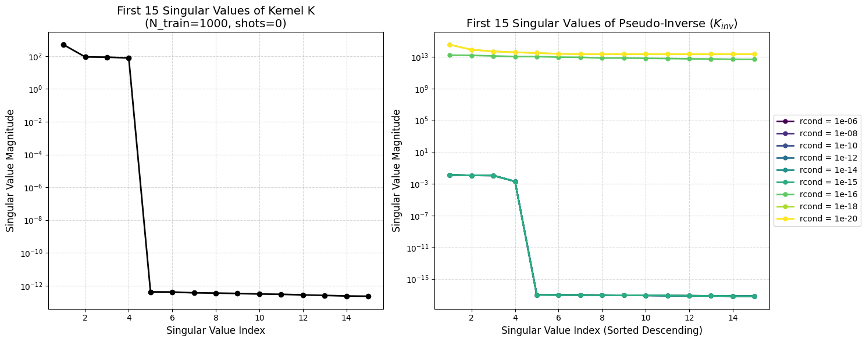
KernelSVD, N_train=1000
Pinv -> rcond = 1e-15 (default)

Slide 10
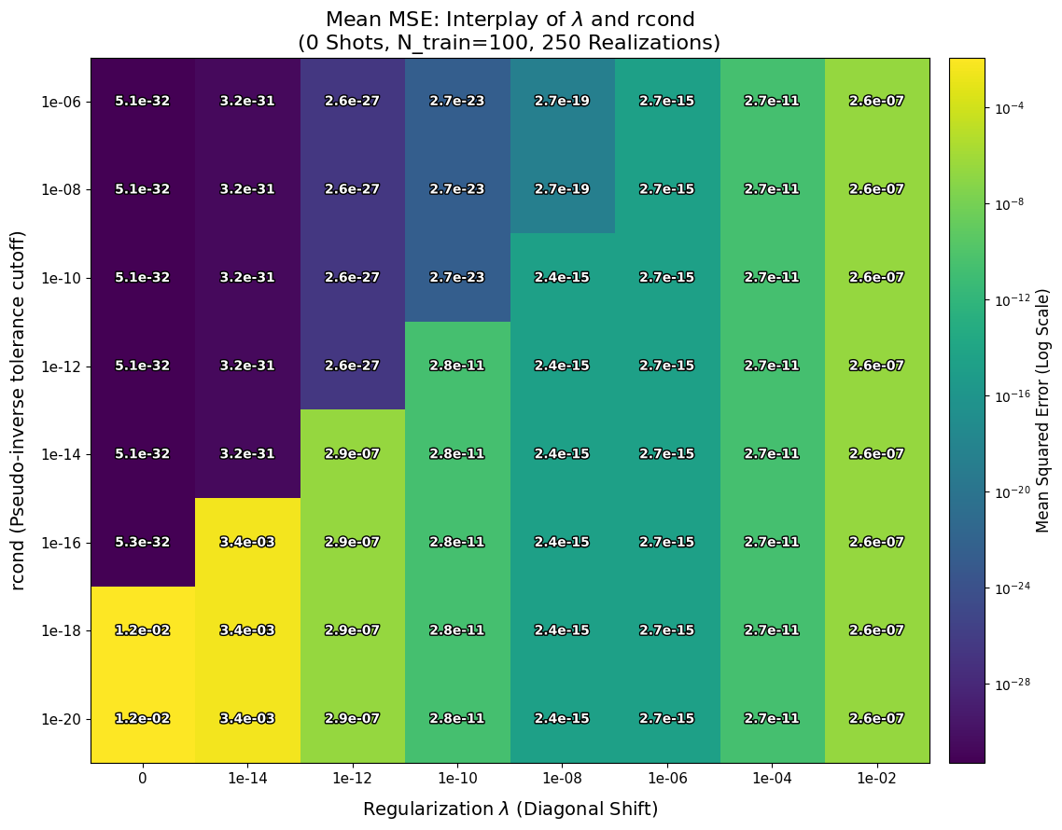
Kernel MSE, $λ −rcond$

Slide 11
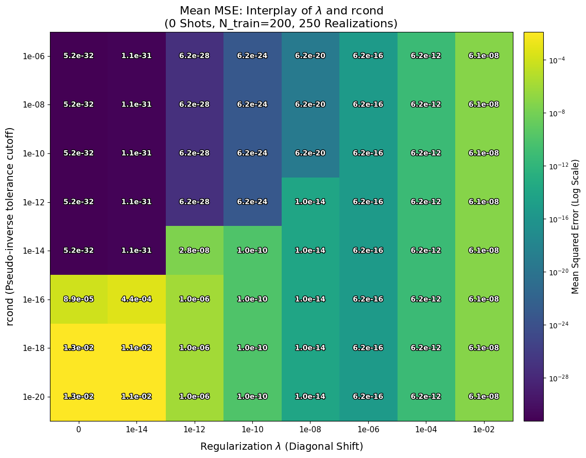
Kernel MSE, $λ −rcond$

Slide 12
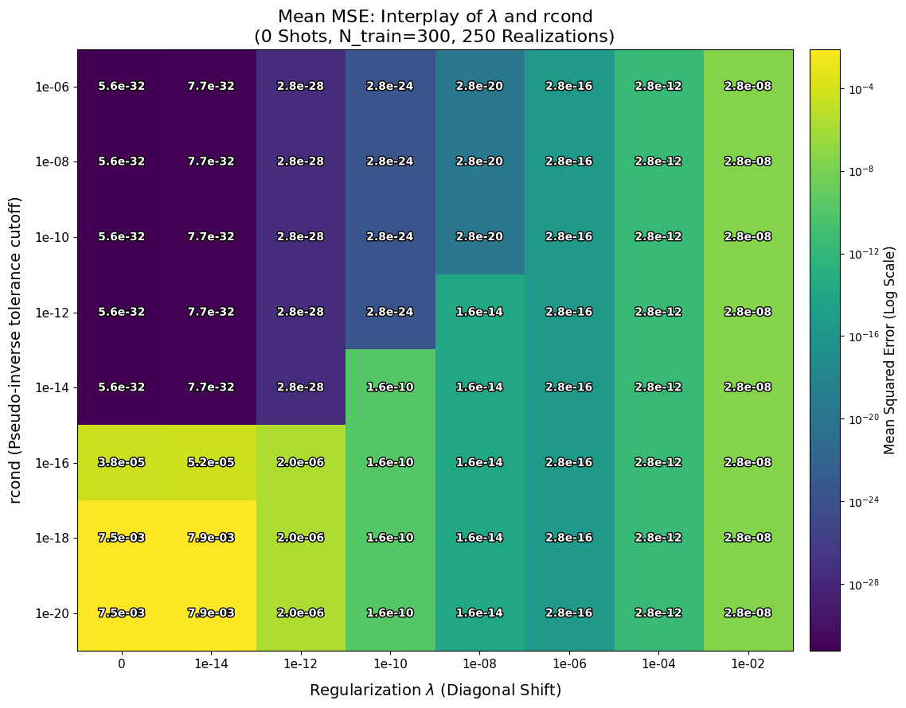
Kernel MSE, $λ −rcond$

Slide 13
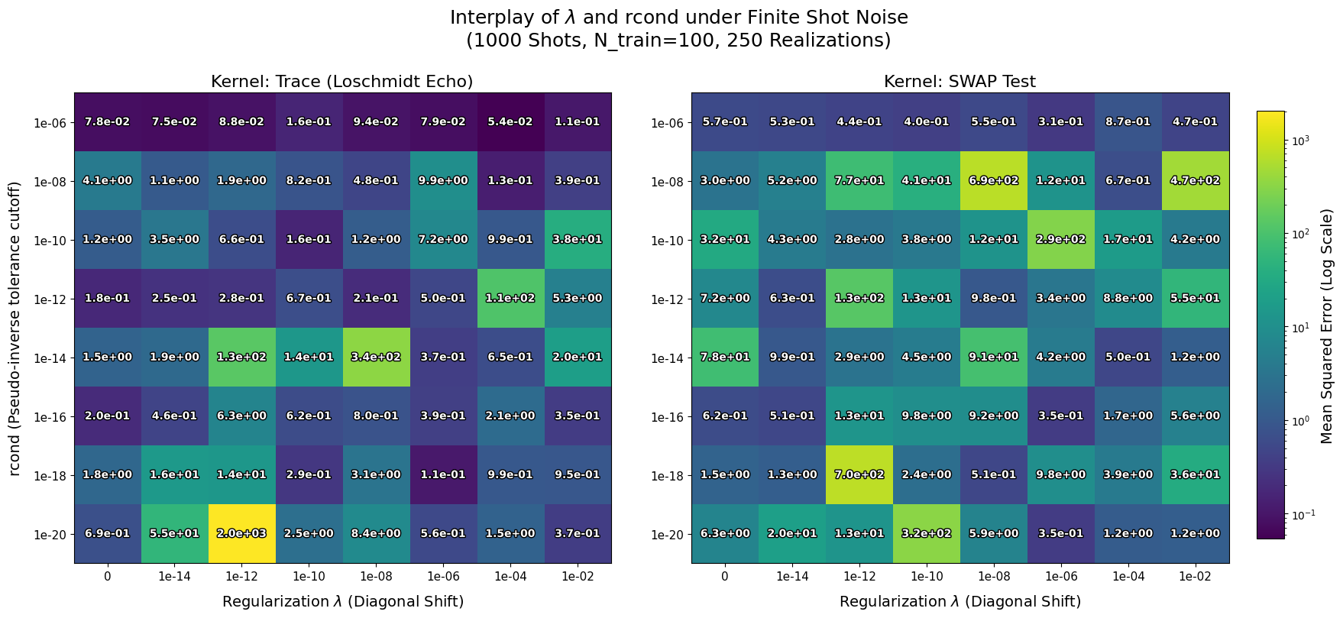
Noisy Kernel MSE, $λ −rcond$

Slide 14
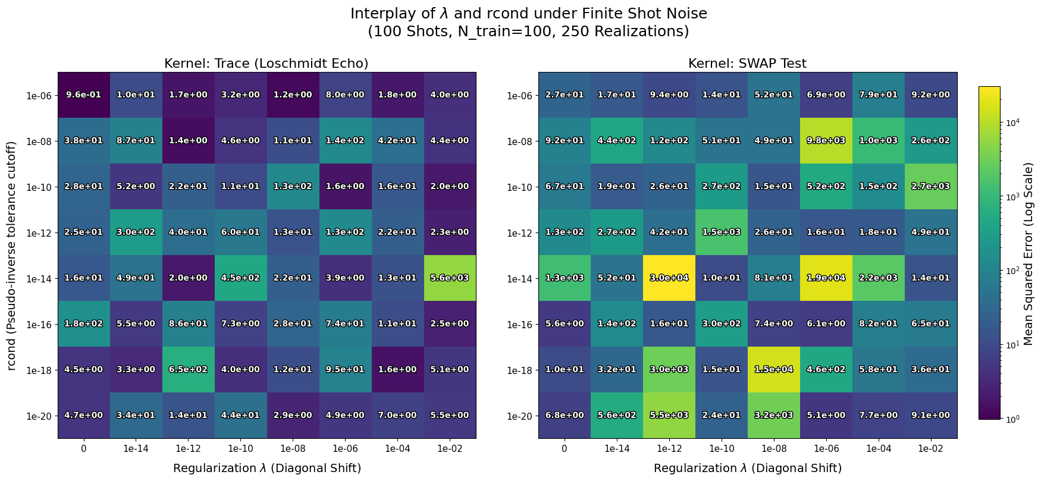
Noisy Kernel MSE, $λ −rcond$

Slide 15
Scaling (again QELM vs Kernel)

Slide 16
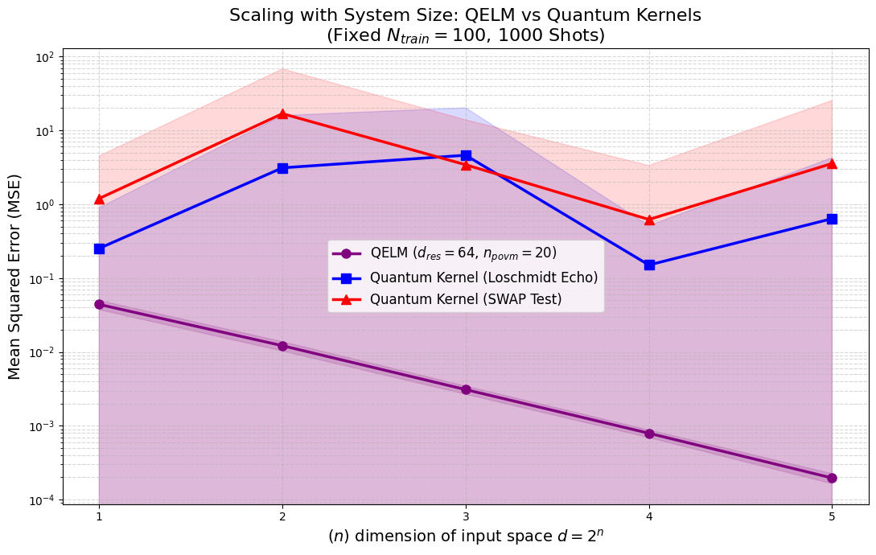
OLD ONE

